Slide 1
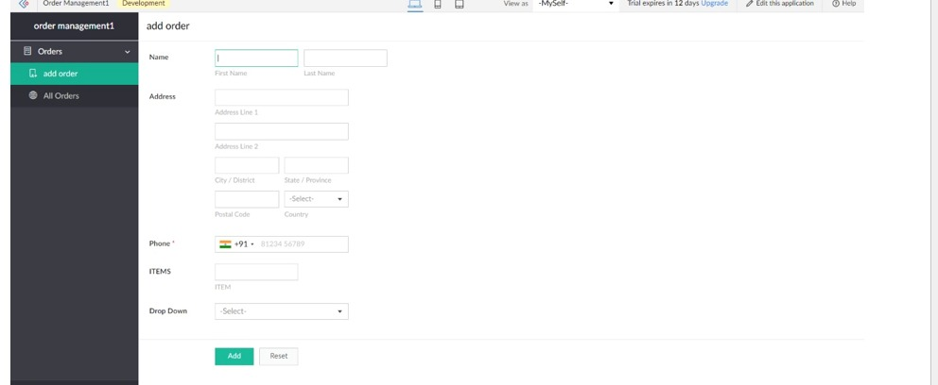
EXPERIMENT 1 Create a simple cloud software application and provide it as a service using any Cloud Service Provider to demonstrate Software as a Service (SaaS).

